Slide 1

Project Title -SEASONAL AGRICULTURE PERFORMANCE ANALYSIS
[Student Name- Jatin Tanwani
College Name- Arya College of Engineering]
AICTE STU ID : STU678131e858a651736520168

Slide 2

PROBLEM STATEMENT
(Agricultural activities are influenced by seasonal variations in environmental conditions, farming practices, resource availability and market conditions. As a result, agricultural performance may differ from one season to another.
However, raw agricultural data does not clearly explain how agricultural performance changes across seasons or what patterns can be observed in different seasonal conditions.
The project aims to analyze the agricultural dataset and identify meaningful seasonal patterns, trends, relationships and variations in agricultural performance.

Slide 3
Project Description
[ Seasonal Agriculture Performance Analysis is a data analytics project that analyzes agricultural activities across different seasons, geographical areas and farming conditions.
The project uses agricultural data related to farming practices, environmental conditions, resource usage, crop production and economic performance.
The data is cleaned and prepared using Python and Pandas, followed by exploratory analysis and visualization to identify seasonal patterns, trends, relationships and differences in agricultural performance.
The analysis helps understand how factors such as environmental conditions, resource usage, crop production and economic outcomes vary across seasons.]

Slide 4

WHO ARE THE END USERS?
Farmers and Agricultural StakeholdersTo understand seasonal agricultural performance and resource usage.
Agricultural PlannersTo support evidence-based seasonal agricultural planning.
Agricultural ResearchersTo study seasonal patterns, trends and relationships in agricultural data.
Data Analysts and StudentsTo analyze agricultural datasets and identify meaningful insights.

Slide 5

Technology Used
Python — Data analysis and processing
  Pandas — Data cleaning and manipulation
  NumPy — Numerical operations
  Matplotlib — Data visualization
  Jupyter Notebook — Analysis and documentation
  CSV Dataset — Agricultural data source

Slide 6
RESULTS
RESULT 1 — DATASET OVERVIEW
Dataset Before Cleaning
Total Records: 4,000
Total Columns: 28
Duplicate Rows: 0
Missing Rainfall: 48
Missing Soil Moisture: 40
Missing Yield: 32
Data Cleaning Performed
Missing Rainfall → filled using season-wise median
Missing Soil Moisture → filled using season-wise median
Missing Yield → 32 rows removed
Text values → standardized
Duplicate check → no duplicates found
Final Dataset
3,968 records
28 columns
0 missing values
0 duplicate rows

Slide 7
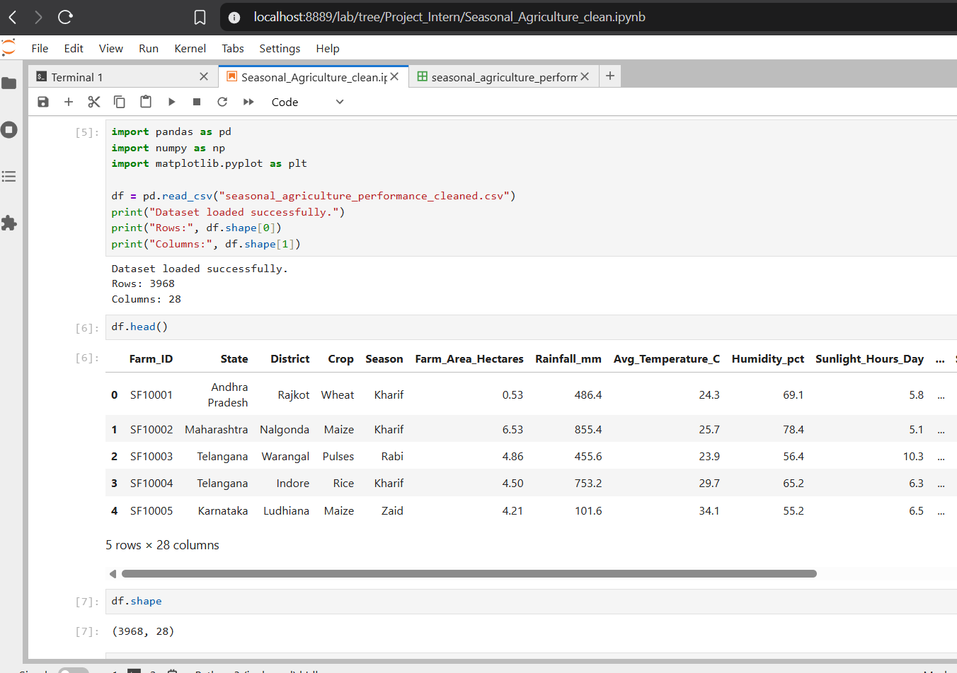
RESULTS
[Add screen shots of your code ]

Slide 8
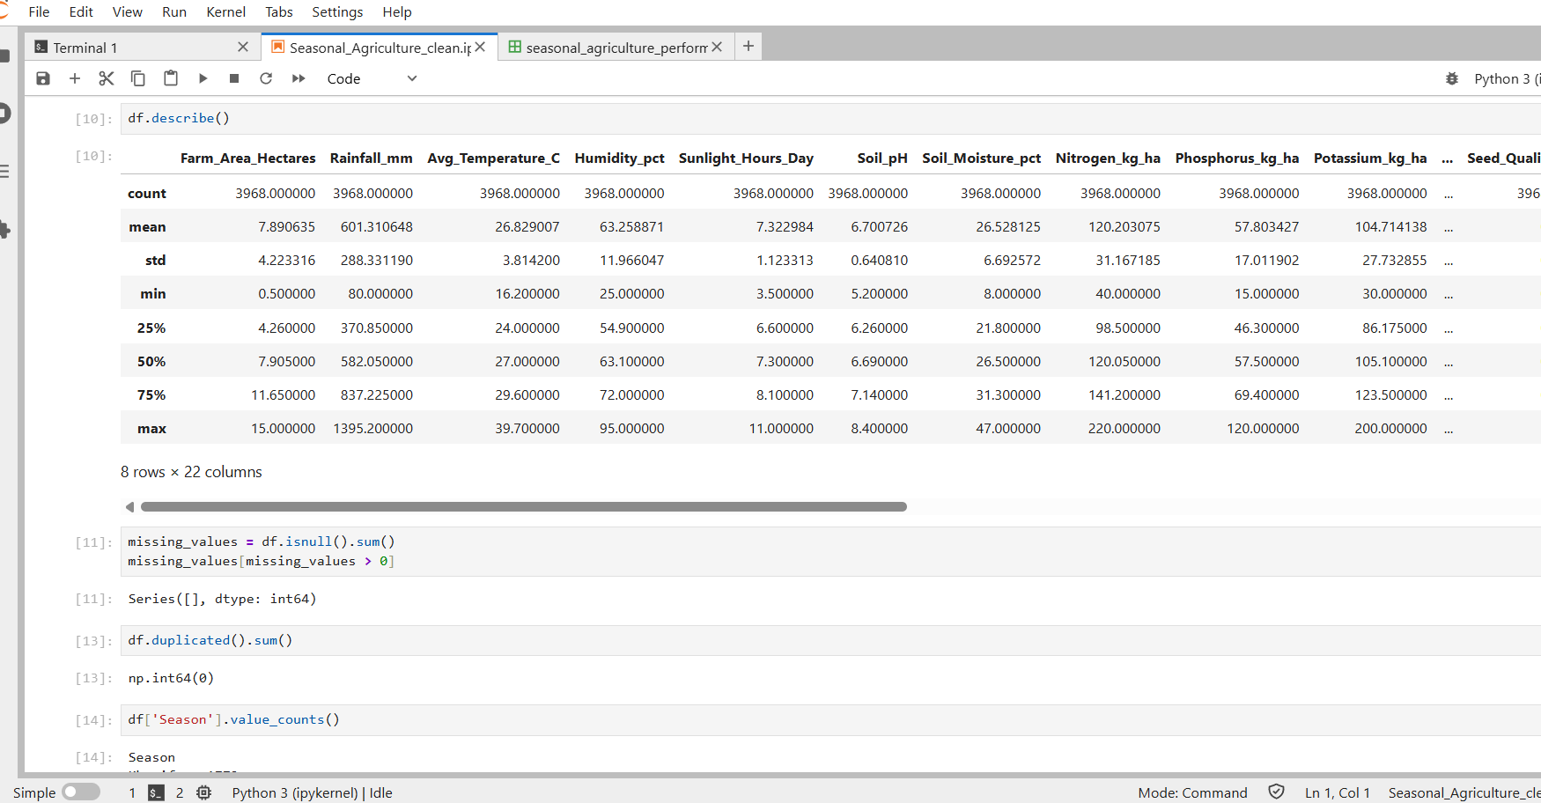
RESULTS
[Add screen shots of your code ]

Slide 9
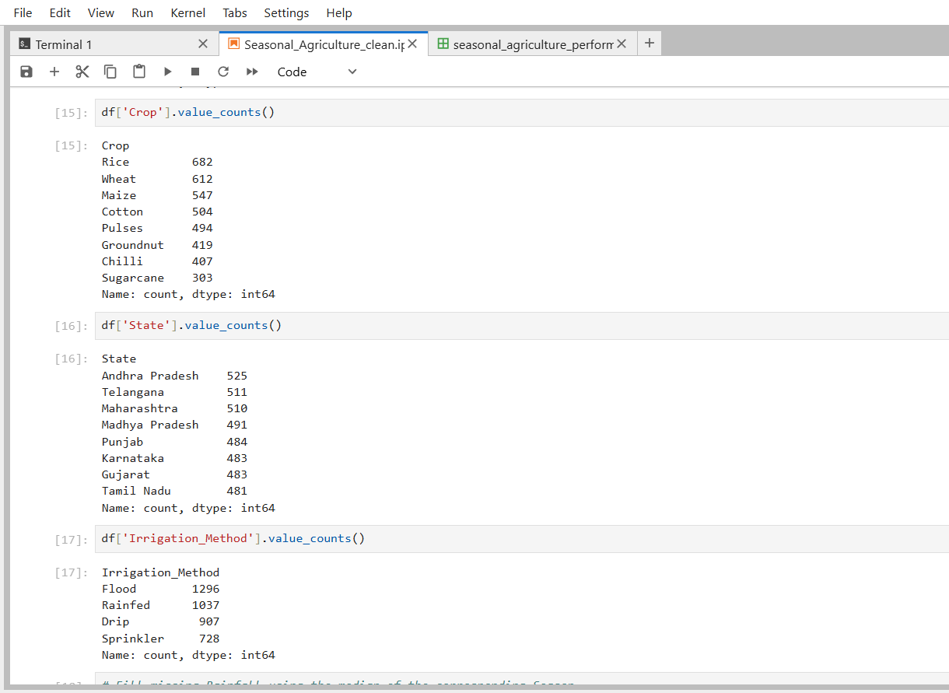
RESULTS
[Add screen shots of your code ]

Slide 10
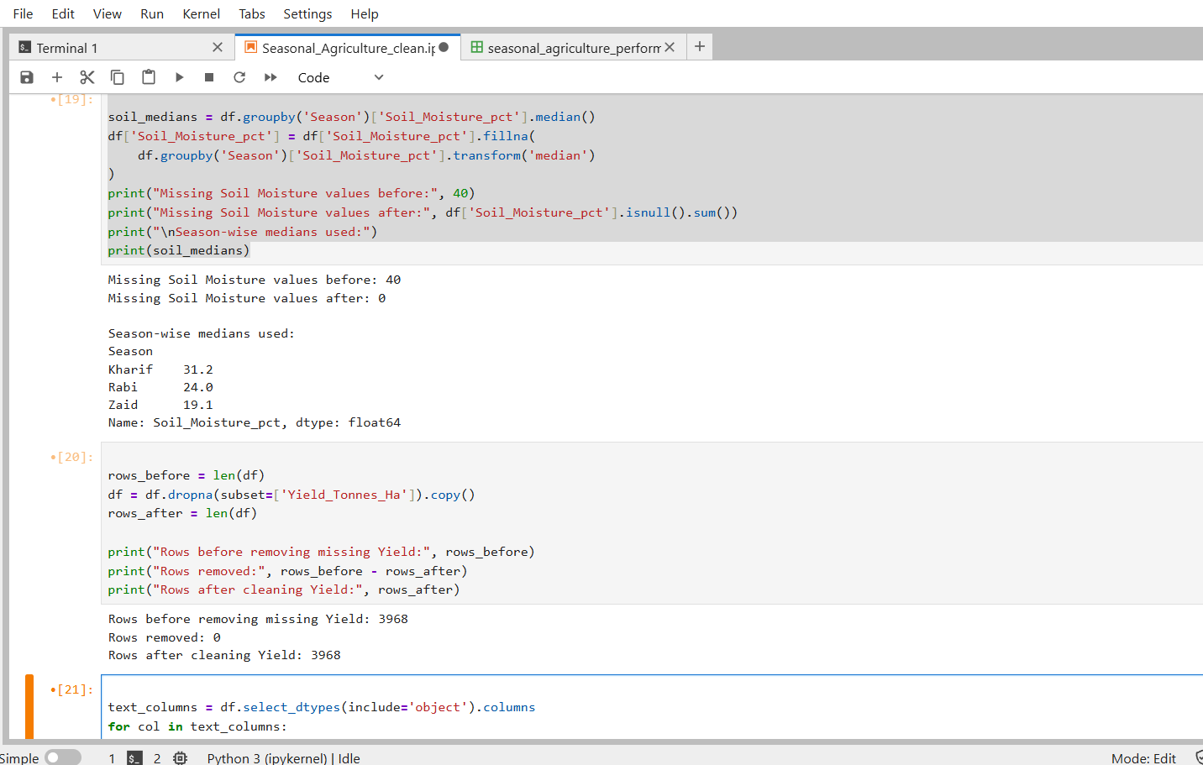
RESULTS
[Add screen shots of your code ]

Slide 11
Future scope
Advanced Predictive Analysis
Develop models to predict crop yield and agricultural performance.
Real-Time Agricultural Data
Integrate live weather, rainfall and environmental data.
Regional-Level Analysis
Expand analysis to more states, districts and agricultural regions.
Crop Recommendation
Develop a system to support suitable crop selection based on seasonal conditions.
Resource Optimization
Analyze water, fertilizer and pesticide usage to support efficient resource planning.
Interactive Dashboard
Develop an interactive dashboard for farmers and agricultural stakeholders.

Slide 12
GitHub Link
https://github.com/Jatin-Tanwani/Seasonal_Agriculture_DA_Project.git

Slide 13
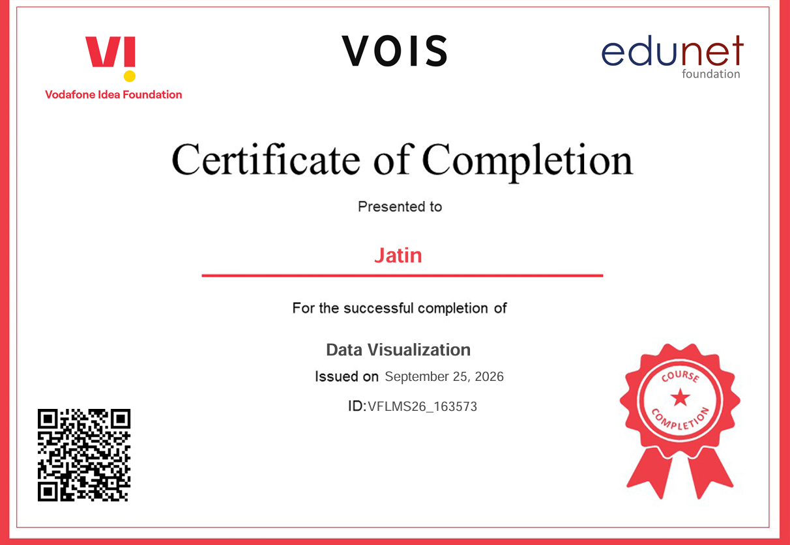
VOIS Course completion certificate -
Course name- Data Visualization

Slide 14
Thank you
.
.

